Slide 1
Who Cares? Family Caregiving Experiences of our Healthcare Providers Johns Hopkins Center on Aging & Health (COAH) Scientific Seminar Series, 03/06/23
Kimberly A. Skarupski, PhD, MPH
Professor, Geriatric Medicine & Gerontology (SOM); Senior Associate, COAH
Professor, Epidemiology (BSPH) kskarupski@jhmi.edu

Slide 2
Disclosure Summary
Kimberly A. Skarupski
March 6, 2023
No individual with the opportunity to affect this educational content has indicated any financial interests or commercial entity relationships.

Slide 3
Acknowledgements
Project Title: Johns Hopkins University Survey of Caregiving Resources: Faculty Awareness and Access
Investigative Team: David Roth, Chris Durso, Kim Skarupski, Erica Twardzik, Tim Sanders, Vishal Sekhon
Funding: Dr. Durso provided partial funding for Redcap survey preparation. The rest of us have been doing this work PURELY as an uncompensated service to the University.

Slide 4
Agenda
Share our survey results & engage in conversation around the three survey topics:
I. Caregiver & Care Recipient Characteristics
II. Caregiver Strain
III. Caregiving Resources

Slide 5
Our Goals: to inform, inspire, and invite you…
(to join us on a modest ‘Organizational Changy’ thingy, Kotter, 2011, 2012)
Creating a sense of urgency
Guiding coalition
Vision and strategy
Communicating the vision
Identify obstacles (empowering people)
Generating short-term wins
Sustaining change
Institutionalizing/anchoring the change

Slide 6
Population Demographics (green = worksheet answers)
Did you know that…
Adults age 55+ = 29.4% of the US population? (2019 data)
There is no mandatory retirement for medical school faculty?
And that there is an anticipated need for physicians due to estimated shortages in the next decade?
Which means that academic medicine faculty will likely remain in the workforce longer than in previous decades?
Average age of FT med school faculty, nationally:
1987: 44.7 (faculty age 55+ = 19%)
2019: 49.1 (faculty age 55+ = 31%)
2021, 51.7 (faculty age 55+ = 28.3%) @ Hopkins SOM
Notes:
(med. 49, mode 40)

Slide 7
So, we’re getting older! Who cares?
Life expectancy is increasing:
Average woman age 65 expected to live 20.5 more years
Average woman age 65 expected to live 18 more years
As populations age and live longer, what will inevitably rise?
Caregiving needs
Lower fertility rates have reduced number of available family members to provide/assist with care; so who has a greater likelihood of serving as a caregiver to parents/spouse/other family members?
Me (you)!

Slide 8
Our Goals: to inform, inspire, and invite you…
(on a modest ‘Organizational Changy’ thingy, Kotter, 2011, 2012)
Creating a sense of urgency ?
Guiding coalition
Vision and strategy
Communicating the vision
Identify obstacles (empowering people)
Generating short-term wins
Sustaining change
Institutionalizing/anchoring the change

Slide 9
3-minutes – discuss amongst yourself/yourselves…
Who cares?
Am I currently providing care on an on-going basis to a family member, friend, or neighbor with a chronic illness or a disability?
such as dressing, bathing, grooming this person, managing bills, arranging for medical care, watching or supervising this person, or providing transportation?
Will I be a caregiver in the future?
Will I need someone to care for me?
https://www.youtube.com/watch?v=a01QQZyl-_I
Notes:
Youtube: Under Pressure (Queen & David Bowie)

Slide 10
Backdrop (faculty development/mentoring hat)
At least 4 important points for early-career faculty members:
Marry your interests (mine are faculty development and gerontology)
Play your work forward (I thought ahead to additional scholarship we could generate and added caregiving questions to a survey about retirement)
Leverage opportunities by building your communities (invite diverse people to your table to generate papers)
Be patient. This process started in 2015.
This Photo by Unknown Author is licensed under CC BY-NC
Notes:
AAMC GFA – Meenakshi Singh, 2015; Skarupski 2016; Leveraged my leading this nationwide survey opportunity to include CG questions.

Slide 11
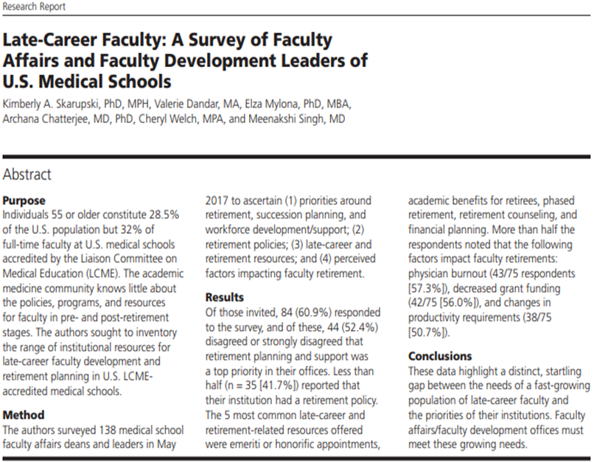
Skarupski KA, Dandar V, Mylona E, Chatterjee A, Welch C, Singh M. Late career faculty: A survey of faculty affairs and faculty development leaders of U.S. medical schools. Acad Med. 2020 ;95(2):234-240.
Notes:
Points: Marry your interests (FAC DEV and gerontology)! Leverage opportunities (ADDED CG questions); Build community (put more leaves in the table); Be patient (2015-2023…)
AAMC GFA – Meenakshi Singh, 2015; Skarupski 2016; Leveraged my leading this nationwide survey opportunity to include CG questions.

Slide 12
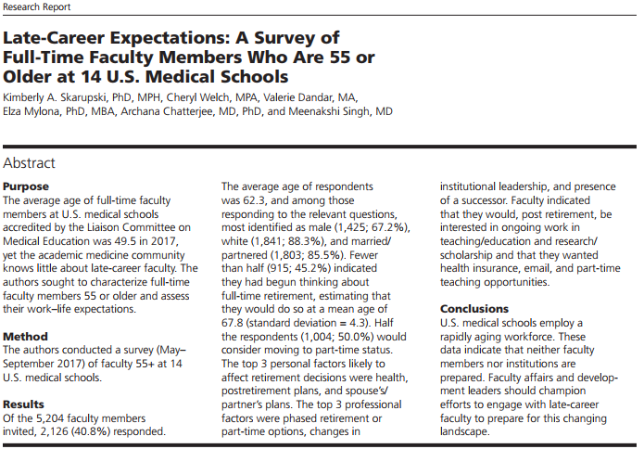
Skarupski KA, Welch C, Dandar V, Mylona E, Chatterjee A, Singh M. Late-Career Expectations: A survey of full-time faculty members who are 55 or older at 14 U.S. medical schools. Acad Med. 2020; 95(2):226-233.
Notes:
AAMC GFA – Meenakshi Singh, 2015; Skarupski 2016; Leveraged my leading this nationwide survey opportunity to include CG questions.

Slide 13
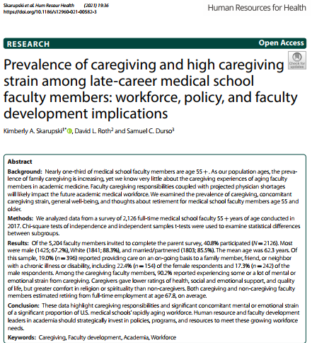

Slide 14
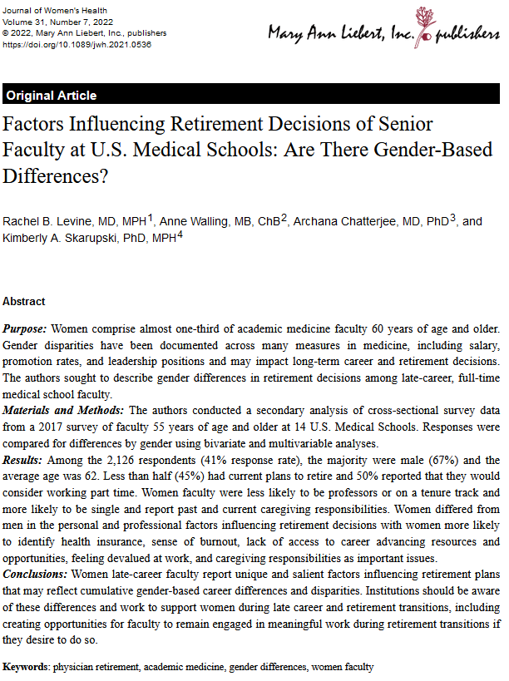

Slide 15
Hit a nerve! Marketing, media attention, buzz!
Marketing resulted in emails, text messages, and personal conversations
Spurred us to action (summer, 2021)
Goal: to understand the caregiving experiences of Johns Hopkins faculty members and their awareness of resources; to promote change that will help our faculty families dealing with disabilities
Survey! Descriptive study (not hypothesis-testing), sorry Alden

Slide 16
Methods
Sample = all FT and PT faculty members with primary appointments in DOM (1,465) - excluded faculty with adjunct, emeritus, or only secondary appointments (n=412)
Recap survey (thanks to Tim Sanders) invitation emailed to 1,053 faculty members
(+ 3 reminders)
Primary question: “Are you currently providing care on an on-going basis to any family member, friend, or neighbor with a chronic illness or disability? This would include any kind of regular help with basic activities such as dressing, bathing, grooming this person, preparing meals, managing bills, arranging for or helping to coordinate medical care, managing medications, watching or supervising this person, or providing transportation.” (We also asked, “Over the past year, have you provided care…”).
Secondary question: “How much of a mental or emotional strain is it on you to provide this care?”
Tertiary question: Are you aware of this (Hopkins resource), have you used it in the past, currently, or anticipate using it, & rate your satisfaction
Notes:
Summer, 2021
In October, we surveyed all full-time and part-time faculty members (N=1,465) with a primary appointment in the Department of Medicine (DOM) to assess: the prevalence of caregiving for family members, friends, or neighbors with a chronic illness or disability; anticipated caregiving needs; and awareness of caregiving resources and policies. Here is a brief summary of our findings (see email invitation below).
In the total DOM faculty population of 1,465, we excluded faculty with adjunct, emeritus, or only secondary appointments (n=412) and sent the survey invitation to 1,053 faculty members. The survey link was emailed on October 18, 2022 and after three reminders sent at 2-week intervals, we had 208 faculty members who responded, for a response rate of 19.8%.

Slide 17
Survey Introductory Text
The following confidential survey is an important opportunity for you to share your experiences with disability in your family and if that has affected your work as a faculty member in the Johns Hopkins Department of Medicine. The goal of the survey is to better understand the experiences of Johns Hopkins faculty members and their awareness of resources to help families dealing with disabilities. Whether you are providing care for someone with a disability now, or have done so in the past, or have disabilities of your own, or have never had any of these experiences, we would appreciate your participation in our brief survey. It should take you between 5 and 20 minutes to complete the survey, depending on your experiences and responses.
Your participation in this on-line survey is purely voluntary, and you may discontinue at any time. The survey responses will be analyzed by statisticians in the Johns Hopkins Center on Aging and Health, and your responses to all questions will be kept completely confidential and will not be disclosed to any of your colleagues or supervisors.

Slide 18
Redcap Survey – DOM Faculty, October, 2022
1053 faculty members received up to 3 emails
830 did not respond
223 responded (21%)
14 opted out
209 completed survey (20%)
76 (36%) current caregivers
16 (8%) recent caregivers
117 non-caregivers
9 spouses (12%)
53 parents or parents-in-law (70%)
3 spouses (19%)
9 parents or parents-in-law (56%)
Notes:
Remember: 76 of survey respondents (NOT all faculty) are CGs

Slide 19
Four Survey Respondent Groups
1053 faculty members received up to 3 emails
830 did not respond
223 responded (21%)
14 opted out
209 completed survey (20%)
76 current caregivers
(36%)
16 recent caregivers
(8%)
117 non-caregivers
(56%)
Important point: More than half (76+16+30=122, [58%]) reported current caregiving, recent caregiving, or the wish to be caregiving if they had “enough time.”
30 want to be caregivers,
Yes to II.27 (14%)
87 report no family or
friends with disabilities
needing their help,
No to II.27 (42%)
Notes:
Basically, of the 209 who completed the survey, we can put them into one of the following 4 groups:
76 current caregivers – mostly caring for parents, many of whom live far away, lots of strain (36%)
16 “recent” caregivers – not current caregivers but caregivers within the past year, again mostly parents, and some strain retrospectively (8%)
30 “want to be” caregivers – persons who are neither current nor recent caregivers, but said they have “family members or friends with… disabilities” … they would like to help “but don’t have enough time” (14%)
87 non-caregivers who report not having any family members or friends with disabilities whom they would like to help (42%)
I think an important point about all of this is that WAY MORE THAN HALF of our respondents (122, 58%) reported current caregiving, recent caregiving, or the wish to be caregiving if they had “enough time.”

Slide 20
I. Caregiver & Care Recipient Characteristics
 | TOTAL (N = 209) | Current CGs (n = 76 [36%]) | Recent CGs (n = 16 [8%]) | Wishful CGs (n = 30 [14%]) | Not Caregiving (no one needs their help) (n = 87 [42%])
Years at Hopkins | 15.8 | 17.9 | 13.7 | 15.2 | 14.4
Age | 51.1 | 54.0 | 48.9 | 48.6 | 49.7
Females | 54.9% | 62.7 | 60.0 | 64.3 | 44.2
Non-white (95% non-Hispanic) | 31.1% | 36.8 | 25.1 | 36.6 | 25.3
Married | 85.9% | 86.5 | 87.5 | 90.0 | 83.7
MDs | 78.7% | 79.0 | 73.3 | 70.0 | 82.6
FT | 83.7% | 77.6 !? | 87.5 | 93.3 | 85.1
Notes:
Race: AA, A/PI, Mixed, other/Missing vs. white

Slide 21
Caregiving - Comparisons
N = 43,099 community-dwelling adults (REGARDS) | N=13,270 community-dwelling adults REGARDS Follow-up study | N=2,126 FT faculty age 55+, from 14 US medical schools | N=209 FT/PT Hopkins DOM faculty
12.0% CGs | 12.4% CGs | 19% CGs | 36% CGs + 8% recently + 14% wishful
CG ave. age = 63.5 | 71.9 | 62.3 | 51.5 (current & recent)
Roth DL, Perkins M, Wadley VG, Temple EM, Haley WE. Family caregiving and emotional strain: associations with quality of life in a large national sample of middle-aged and older adults. Quality of Life Research. 2009;18(6):679–88. | Roth DL, Haley WE, Rhodes JD, Sheehan OC, Huang J et al. Transitions to family caregiving: Enrolling incident caregivers and matched non-caregiving controls from a population-based study. Aging Clinical and Experimental Research. 2020;32(9):1829-1838. | Skarupski KA, Roth DL, Durso SC. Prevalence of caregiving and high caregiving strain among late-career medical school faculty members: Workforce, policy, and faculty development implications. Human Resources for Health. 19 March 2021. DOI:10.1186/s12960-021-00582-3. | Johns Hopkins University Survey of Caregiving Resources: Faculty Awareness and Access, Department of Medicine Faculty, October 2022. David Roth, Chris Durso, Kim Skarupski, Erica Twardzik, Tim Sanders, Vishal Sekhon

Slide 22
*Surprise! Gender differences are diminishing!
Table 1. Faculty survey respondent sociodemographics, by caregiving type
 | TOTAL (N = 209) | Current CGs (n = 76) | Recent CGs (n = 16) | Wishful CGs (n = 30) | Not Caregiving (no one needs their help) (n = 87)
Years at Hopkins | 15.8 (11.3) | 17.9 (10.9) | 13.7 (9.5) | 15.2 (9.0) | 14.4 (12.5)
Age mean (SD) range | 51.1 (12.0) 30-81 | 54.0 (11.0) 34-79 | 48.9 (9.7) 32-65 | 48.6 (8.9) 35-65 | 49.7 (13.7) 30-81
Female, # (%) Male | 112 (54.9) 97 (45.1) | 47 (62.7) 29 (37.3) – [30% of men] | 9 (60.0) 7 (40.0) [7% of men] | 18 (64.3) 12 (35.7) [12% of men] | 38 (44.2) 49 (55.8) [51% of men]
Wolff et al. found in longitudinal national samples, that more men are taking on family caregiving roles in more recent surveys (31.8% in 1999 to 36.3% in 2015), especially for non-dementia caregiving [17]. However, there has been no published literature exploring the prevalence of caregiving and differences by gender among late-career faculty members
Wolff JL, Mulcahy J, Huang J, Roth DL, Covinsky K, Kasper JD. Family Caregivers of Older Adults, 1999-2015: Trends in Characteristics, Circumstances, and Role-Related Appraisal. The Gerontologist. 2018;58(6):1021-32.

Slide 23
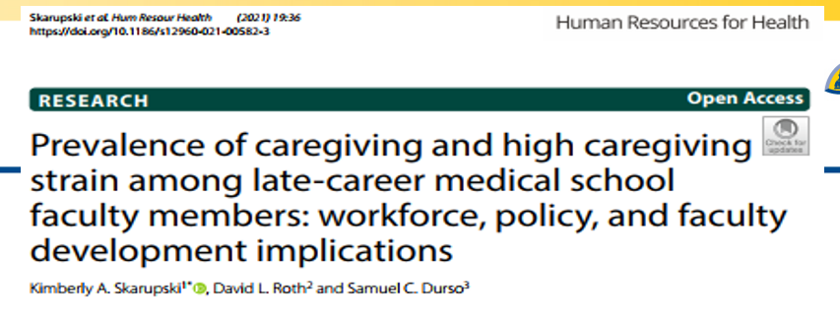
Results
Skarupski
KA, Roth DL, Durso SC. Prevalence of caregiving and high caregiving strain among late
-
career
medical school faculty members: Workforce, policy, and faculty development implications. Human Resources for
Health
. 2021. In press. DOI:10.1186/s12960
-
021
-
00582
-
3.
Notes:
Wolff JL, Mulcahy J, Huang J, Roth DL, Covinsky K, Kasper JD. Family Caregivers of Older Adults, 1999-2015: Trends in Characteristics, Circumstances, and Role-Related Appraisal. The Gerontologist. 2018;58(6):1021-32.
Wolff et al. found in longitudinal national samples, that more men are taking on family caregiving roles in more recent surveys (31.8% in 1999 to 36.3% in 2015), especially for non-dementia caregiving [17]. However, there has been no published literature exploring the prevalence of caregiving and differences by gender among late-career faculty members.

Slide 24
Organizational Change (Kotter, 2011, 2012)
Creating a sense of urgency ?
Guiding coalition
Vision and strategy
Communicating the vision
Identify obstacles (empowering people)
Generate short-term wins
Sustaining change
Institutionalizing/anchoring the change

Slide 25
Other “minor” considerations just “for fun”…
In what state/country do the humans who raised you live?
Sandwichers/tweeners – how many caregivers of parents/spouses or other family members are ALSO providing care to children/grandchildren?
How many of the CGs are single?
Which brings us to…

Slide 26
II. Caregiver Strain
Secondary question: “How much of a mental or emotional strain is it on you to provide this care?”
No strain
Some strain
A lot of strain

Slide 27
3-minutes – discuss amongst yourself/yourselves…
Who cares?
Where’s this “strain”? List stressors.
Do your caregiving responsibilities affect your productivity at work? If so, how?
https://www.youtube.com/watch?v=5rOiW_xY-kc
Notes:
Youtube: REM Hold on

Slide 28
Survey respondents’ open-ended quotes – sound familiar?
Have your caregiving responsibilities affected your productivity at work?
Yes, for sure. I'm exhausted a lot of the time, and there's no time for my own health or exercise. I have an overflowing plate. Support for my dad who is primary caregiver for my mom is hard, and i really can't outsource the coordination or emotional support.
…to maintain my productivity I end up occasionally sacrificing my self-care and sleep.
Both of my parents have Alzheimers and live 2 hours away. I am their primary caretaker and work fulltime as a physician. I cannot take time off or will not meet my RVU targets. I plan to retire early due to this.
It has dampened the chance of productivity
I constantly worry when the phone rings that I'm going to have to rearrange my day due to a fall or other unexpected event
less time for scholarly efforts
I moved to part-time status because my full-time faculty position didn't allow me adequate free time to care for my parents, and didn't pay enough for me to hire other caregivers to provide the care that my parents now need
It's both a time & energy burden, and a cognitive (allostatic) burden to care for a sick family member. Not just the time involved, but time worrying, feeling guilty about not doing more, etc.
There is never enough time to do it all = burnout and lack of self care
yes, I retired from clinical practice.

Slide 29
Faculty hassles?
Getting your own medical appointment?
Hiring someone?
Getting good administrative or clinical support?
Finding time to write and/or do research?
IRB?
Regulatory and compliance modules?
Closing Epic encounters?
Spending less time doing administrative tasks?
Formatting your CV?
Building your promotion dossier?
Pay equity (internally and externally)?
Leadership opportunities?
Being asked to provide ID by security personnel?
Parking?
Child care?
Keeping your family safe from COVID-19 and else?
And on and on and on

Slide 30
You as caregiver!
Ben-Isaac E, Serwint JR. When the physician becomes the caregiver: A review for physicians caring for their elder relatives. Pediatrics in Review 2021;42(8): 405-413.
- your own knowledge gaps (objectivity, failure to recognize subtle changes?)
- challenges navigating “the system”
- emotional experience (parents as patients)!
- visible care (e.g., bills, cleaning, laundry, shopping)
vs. - invisible care (e.g., managing agendas/appointments, giving advice, protection, arranging/stimulating social contact, worrying)
- geography/living arrangements (travel?)
- job as ‘good’ distraction vs. job as ‘bad’ distractor (competing demands)
- resources, flexibility, impact on career trajectory/opportunities

Slide 31
Daily Hassles
“Daily hassles are defined as the little things arising from day-to-day life that can, somehow, irritate, frustrate and/or distress people (Lazarus and Folkman, 1984). These types of events are appraised as salient, harmful or threatening to a person's well-being. Many hassles originate because of an individual's environment, personal behavior patterns, or their interaction.
They include, for instance, annoying practical problems such as having too many responsibilities or not having the necessary resources, and unexpected occurrences as well as arguments and disappointments (Kanner, Coyne, Schaefer and Lazarus, 1981).
Daily hassles might be: situation determined (e.g., unexpected news); rare (e.g., dealing with an aggressive or annoying [colleague/patient]) or; recurrent, either because the person remains in the same context (e.g., workplace), with [in]consistent and [un]predictable demands (e.g., achieve goals) or because of the person's ineffective handling of common situations.”

Slide 32
Redcap Survey – DOM Faculty, October, 2022
1053 faculty members received up to 3 emails
830 did not respond
223 responded (21%)
14 opted out
209 completed survey (20%)
76 (36%) current caregivers
16 (8%) recent caregivers
117 non-caregivers
9 spouses (12%)
53 parents or parents-in-law (70%)
3 spouses (19%)
9 parents or parents-in-law (56%)
“How much of a mental or emotional strain is it on you to provide this care?
4 no strain (5%)
46 some strain (61%)
26 a lot of strain (37%)
2 no strain (13%)
10 some strain (63%)
4 a lot of strain (25%)
Notes:
Remember: 76 of survey respondents (NOT all faculty) are CGs

Slide 33
Caregiving Strain - Comparisons
N = 43,099 community-dwelling adults (REGARDS) | N=13,270 community-dwelling adults REGARDS Follow-up study | N=2,126 FT faculty age 55+, from 14 US medical schools | N=209 FT/PT Hopkins DOM faculty
12.0% CGs | 12.4% CGs | 19% CGs | 36% CGs + 8% recently + 14% wishful
CG ave. age = 63.5 | 71.9 | 62.3 | 51.5 (current & recent)
no strain: 33% | 29% | 9.8% | 6.5%
some strain: 49% | 52% | 68.6% | 61%
a lot of strain: 18% | 19% | 21.6% | 33%
Roth DL, Perkins M, Wadley VG, Temple EM, Haley WE. Family caregiving and emotional strain: associations with quality of life in a large national sample of middle-aged and older adults. Quality of Life Research. 2009;18(6):679–88. | Roth DL, Haley WE, Rhodes JD, Sheehan OC, Huang J et al. Transitions to family caregiving: Enrolling incident caregivers and matched non-caregiving controls from a population-based study. Aging Clinical and Experimental Research. 2020;32(9):1829-1838. | Skarupski KA, Roth DL, Durso SC. Prevalence of caregiving and high caregiving strain among late-career medical school faculty members: Workforce, policy, and faculty development implications. Human Resources for Health. 19 March 2021. DOI:10.1186/s12960-021-00582-3. | Johns Hopkins University Survey of Caregiving Resources: Faculty Awareness and Access, Department of Medicine Faculty, October 2022. David Roth, Chris Durso, Kim Skarupski, Erica Twardzik, Tim Sanders, Vishal Sekhon
67% 71% 91% 94%

Slide 34
Our Goals: to inform, inspire, and invite you…
(on a modest ‘Organizational Changy’ thingy, Kotter, 2011, 2012)
Creating a sense of urgency ?
Guiding coalition
Vision and strategy
Communicating the vision
Identify obstacles (empowering people)
Generating short-term wins
Sustaining change
Institutionalizing/anchoring the change

Slide 35
III. Caregiving Resources

Slide 36
Table 4. Hopkins Resources, by Current & Recent Caregivers Combined (n=92)
 | Yes, I am aware of this resource | Yes, I have used this resource | Yes, I am currently using this resource | Do you anticipate using this resource in the near future? Yes No Not sure | If you have used this resource, please rate your satisfaction on a 1-5 scale where 1 is very dissatisfied and 5 is very satisfied.
Backup Care: Reduced fees for in-home care through Care@Work | 30 (33.0) | 5 (16.7) | 1 (20.0) | 3 (10.0) 13 (43.3) 14 (46.7) | 3.9 (0.9) n=9
MySupport: Up to 5 in-person counseling sessions via telephone | 28 (31.5) | 8 (28.6) | 1 (12.5) | 1 (3.6) 15 (53.6) 12 (42.9) | 3.2 (1.0) n=10
Lifemart: Employee discounts for senior care products | 7 (7.8) | 2 (28.6) | -- | -- 3 (42.9) 4 (57.1) | 2.0 (--) n=1
Dependent Care Flexible Spending Accounts | 64 (72.7) | 28 (43.8) | 9 (32.1) | 12 (18.8) 33 (51.6) 19 (29.7) | 3.8 (1.0) n=43
Hopkins-assisted referrals to external agencies such as Area Agencies on Aging and Eldercare Locator | 11 (12.5) | 4 (36.4) | 1 (25.0) | 2 (18.2) 5 (45.5) 4 (36.4) | 3.8 (1.9) n=4
Other (specify): Freq = 1 each for: Care.com; case manager at geriatrics clinic; Healthcare FSA; hired in-home help;
Hopkins Home Care; JHHC/Capable (research study) / physicians; local care staffing agencies; PA-based resource; Alz Assn.; place for mom and Aetna (n=11; 4.2 (1.0))

Slide 37
Table 5. External Resources, by Current & Recent Caregivers Combined (n=92)
 | Yes, I have used this resource | Yes, I am currently using this resource | Do you anticipate using this resource in the near future? Yes No Not sure | If you have used this resource, please rate your satisfaction on a 1-5 scale where 1 is very dissatisfied and 5 is very satisfied.
Respite Care such as Adult Day Services | 1 (1.1) | 1 (100.) | 6 (6.7) 47 (52.8) 36 (40.5) | 5.0 (0) n=2
Home Health Care/Visiting Nurses | 39 (43.3) | 13 (33.3) | 26 (29.2) 27 (30.3) 36 (40.5) | 3.9 (1.0) n=37
Caregiver-focused counseling services or support groups | 1 (1.1) | -- | 8 (9.0) 45 (50.6) 36 (40.5) | 4.0 (-) n=1
Meal Services such as Meals on Wheels | 7 (7.8) | 3 (42.9) | 3 (4.1) 66 (75.0) 19 (21.6) | 4.3 (0.5) n=7
Transportation Services Specifically for Persons with Disabilities | 6 (6.7) | 4 (66.7) | 8 (9.0) 53 (59.6) 28 (31.5) | 4.0 (1.0) n=5
Other Domestic Services (e.g., Shopping, Cooking, Housework, Yardwork) for Persons with Disabilities | 21 (23.3) | 15 (71.4) | 22 (24.7) 34 (38.2) 33 (37.1) | 3.8 (1.0) n=22
Other (Specify): Freq = 1 each for: 24-hour in-home care; hospice (2x); memory care unit in Boston; personal care homes (supervised residential living) and Nursing Homes (SNFs); family, friends, and neighbors; health aide; church community; infusion pharmacy; private duty nurse; self-paid caregivers (n=10; 4.4 (0.5))

Slide 38
Survey respondents’ open-ended quotes
What are some specific things that your employer could do that would help you better balance your work responsibilities with your family life?
Parents/family out of state/country:
have resources to connect with providers out of state. My parents are in Philadelphia and Florida
Provide an easily accessible website that's a resource center of things that are available. My father lives in another state so I'd need to know if the resources were available outside Maryland. I also have 2 struggling young adult children with autism spectrum disorders and this adds stress and takes additional time and mental energy.
Specific to immigrant physicians please support EB-1 applications. This may allow us to support our families in the US, decrease the number of PTOs or FMLA for this specific need.
Communications:
Better advertise the resources available for resources and supports - have a single hotline available (or other central contact) that I could reach out to and discuss needs and be directed to which supports make sense for me and my family.
Better communication about services. Better curation of services that are really useful - eg Perks at Work is not particularly useful but is highly advertised
Daily hassles:
Get rid of Artifact Queries;
Making the EHR more efficient. Making the EP lab more efficient so we have less down time between cases and then I could get home 1.5 hours earlier based on the daily delays and late start times. This would also save JHH tons of money in overtime pay for the staff.
Reducing the burden of research would help.

Slide 39
Survey respondents’ open-ended quotes
Better quality resources:
This is dreaming, I know, but really vetted resources. For example, I need someone to help with financial planning and organization - and I Don't just want a free hour with an organization, but a name - this person can do x, y, and z really well. I have people I can ask about this, but we could have more community about this. A lot of faculty colleagues I know are going through this - how do we learn from each other and not reinvent the wheel? …Also guidance - am I doing the right things? Who qualifies for what? It's a little overwhelming to be honest. I have used some websites of course, but anything to make it easier to get things in place so that I can enjoy the time I have and reduce the stress of managing the basics. This will help me be a happier less stressed person and I think translate into more satisfaction at work too (and perhaps better productivity).
Better childcare options that provide care during hours we actually need. It should not require people to get on the waitlist before they are pregnant to try and get a spot at Bright Horizons.
Provide discounted childcare for all employees and be flexible with work hours to be able to care for a family member of sick or with chronic illness.
Dependent care assistance - the care everywhere program is impossible to schedule - they need a 30 day lead time!
Provide more than 10 days for the supplemented childcare benefit. Provide some guidelines that reduce evening, early morning and weekend responsibilities (eg zoom meetings). Having things like grand rounds at 8AM make it impossible for people who have childcare and other responsibilities to attend. Publicize some of the resources mentioned above more.
Emotional support. Understanding situation. It is not easy to share these types of burdens. No real place to do so without feeling uncomfortable.
Raise salaries to market rates (my current salary is $80k/yr lower than the 10th %tile for academic doctors in the northeastern US in my field). Only those with significant family or external wealth can afford to raise families with the current faculty salaries). I do not want to be rich, but I don't want to have to choose between my job at Hopkins and whether I would like another child.

Slide 40
1:1 Interviews (n= 8/11) - quotes 1/26/23 - 2/24/23
Care.com is the antithesis of backup care (can’t be done last minute when you actually need them). Causes anxiety
They say “all these resources” but no one tells you how they work – need a benefits liaison
If everything at home is stable, you have more energy to work
Make it more palatable to stay here
No resources for faculty who are disabled – no map to get around campus in a wheelchair (and we’re a hospital)!
Home remodeling for accommodations is impossible on Hopkins’ salary
I am under constant stress. What will happen if I get sick?
Need a social worker advocate/concierge
My barber is more help than Hopkins (his wife also has AZ)!
I worry constantly
It’s overwhelming at times. I’m not as proactive as I once was. No energy. I’m doing everything for 2 homes.
I need a list of vetted resources. Connect me with resources in another state.
My parents are aging. A physician is also a son, a daughter!
What if we build people in addition to building buildings?
We love the people at JH, we don’t love JH and JH certainly doesn’t love us back.

Slide 41
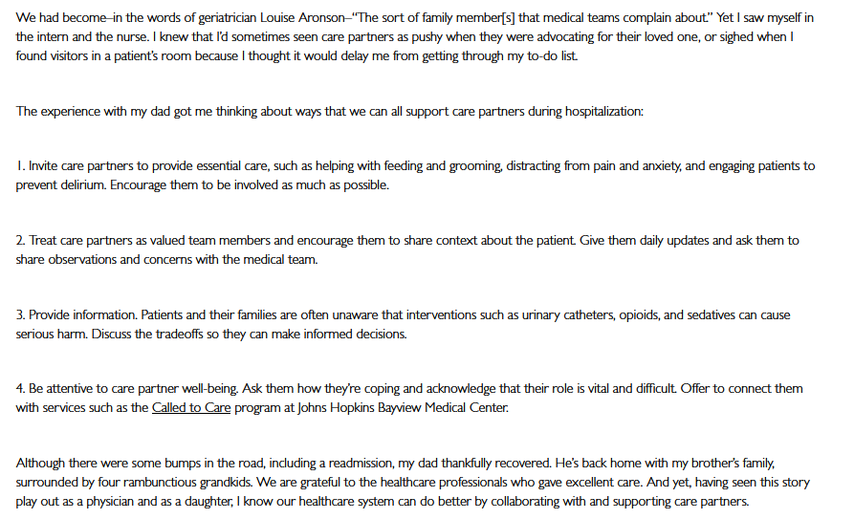
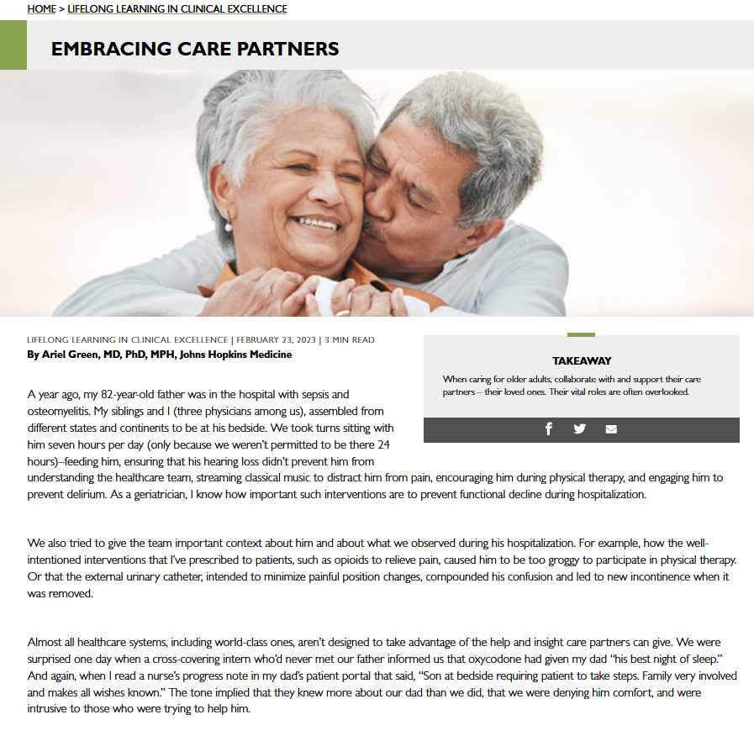
Ariel Green, MD, PhD, MPH https://closler.org/lifelong-learning-in-clinical-excellence/embracing-care-partners

Slide 42
Next Steps

Slide 43
What’s next?
1. Let’s do some out of the box thinking; be innovative/ creative.
2. Yes, my department/division chair and colleagues are supportive, and yet, my institution could…
-start conversations
-provide accommodations (flexibility)
-promote resources (better and more)
-build support (on-site child and adult day care? – we provide housing for undergrads, why not residents, fellows, and day care?)

Slide 44
What can we do now? Virtual Caregiving Community groups!
Caregivers of Spouses/Partners
Tuesday, May 9, 2023, 6:00 p.m. - 7:30 p.m.
Zoom – must register!
Bob Wise, MD (Lead), Kim Skarupski, PhD (Facilitator)
Caregivers of Parents/Family Members
Wednesday, May 17, 2023, 6:00 p.m. – 7:30 p.m.
Zoom - must register!
Catherine Washburn, MD (Lead), Kim Skarupski, PhD (Facilitator)
See the March OFD email in your inbox (or already in your trash)

Slide 45
Agenda & Goals
Share our survey results & engage in conversation around three topics:
I. Caregiver & Care Recipient Characteristics
II. Caregiver Strain
III. Caregiving Resources
Our Goals: to inform, inspire, and invite you in a modest effort we’re calling…

Slide 46
Organizational Change (Kotter, 2011, 2012)
Creating a sense of urgency ?
Guiding coalition
Vision and strategy
Communicating the vision
Identify obstacles (empowering people)
Generate short-term wins !
Sustaining change
Institutionalizing/anchoring the change

Slide 47
The Leadership Challenge (Kouzes & Posner, 2012)
Model the way
Inspire a shared vision
Challenge the process
Enable others to act
Encourage the heart
Lead! (or at least be a “courageous follower”
– by standing up to and for our leaders!, Chaleff, 1995)
CHALLENGE INERTIA!
Notes:
Hopkins, 1893 (130 years of tradition unimpeded by progress)

Slide 48
We appreciate you!
Thank you for investing your time with us today.
kskarupski@jhmi.edu
410-925-0257 (cell)
https://www.youtube.com/watch?v=HNBCVM4KbUM
Notes:
Youtube: Bob Marley Three Little Birds

