Slide 1
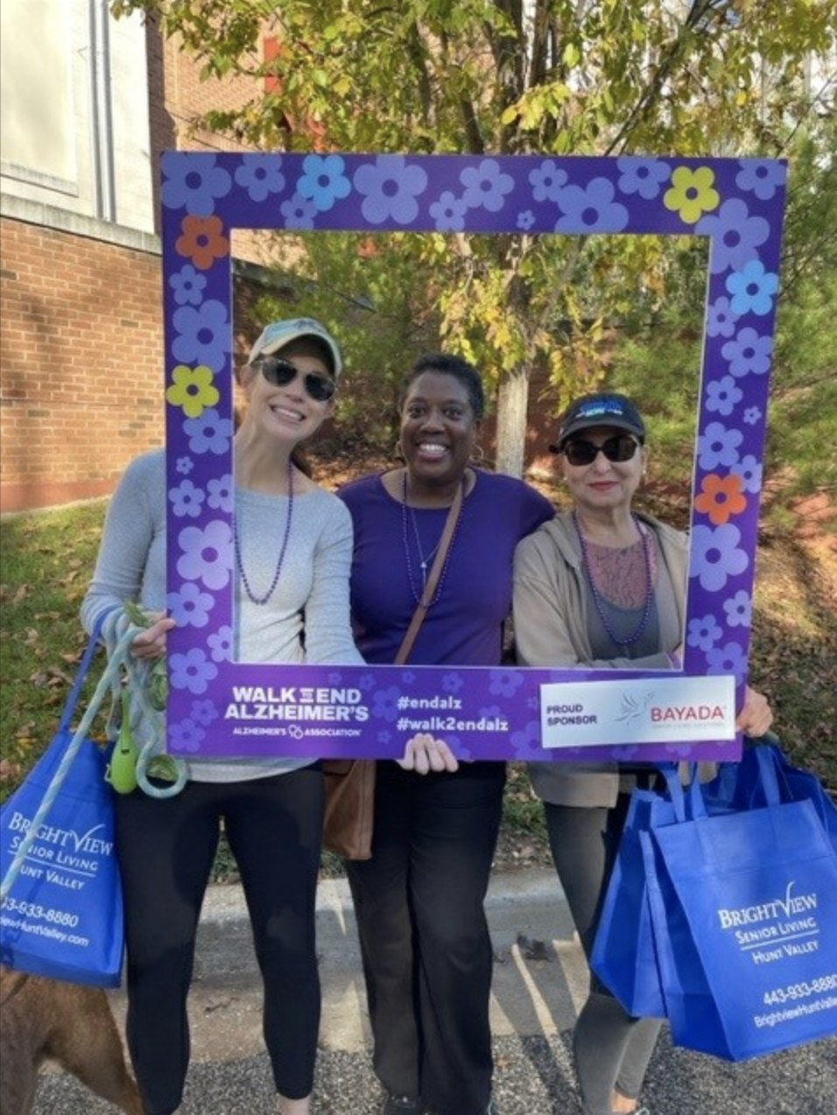
The Johns Hopkins
Aging & Alzheimer’s Centers
2023 #Walk2ENDAlz Team
The 2023 Johns Hopkins Aging & Alzheimer’s Centers Walk Team was sponsored by the following Johns Hopkins centers: Alzheimer’s Disease Research Center; Alzheimer’s Disease Resource Center for Minority Aging Research; Hopkins’ Economics of Alzheimer’s Disease & Services Center; Memory and Alzheimer’s Treatment Center; Center on Aging & Health; and the Older Americans Independence Center.
Pictured: Jennifer Schrack; Monique Lee; and Marcela Blinka.

Slide 2
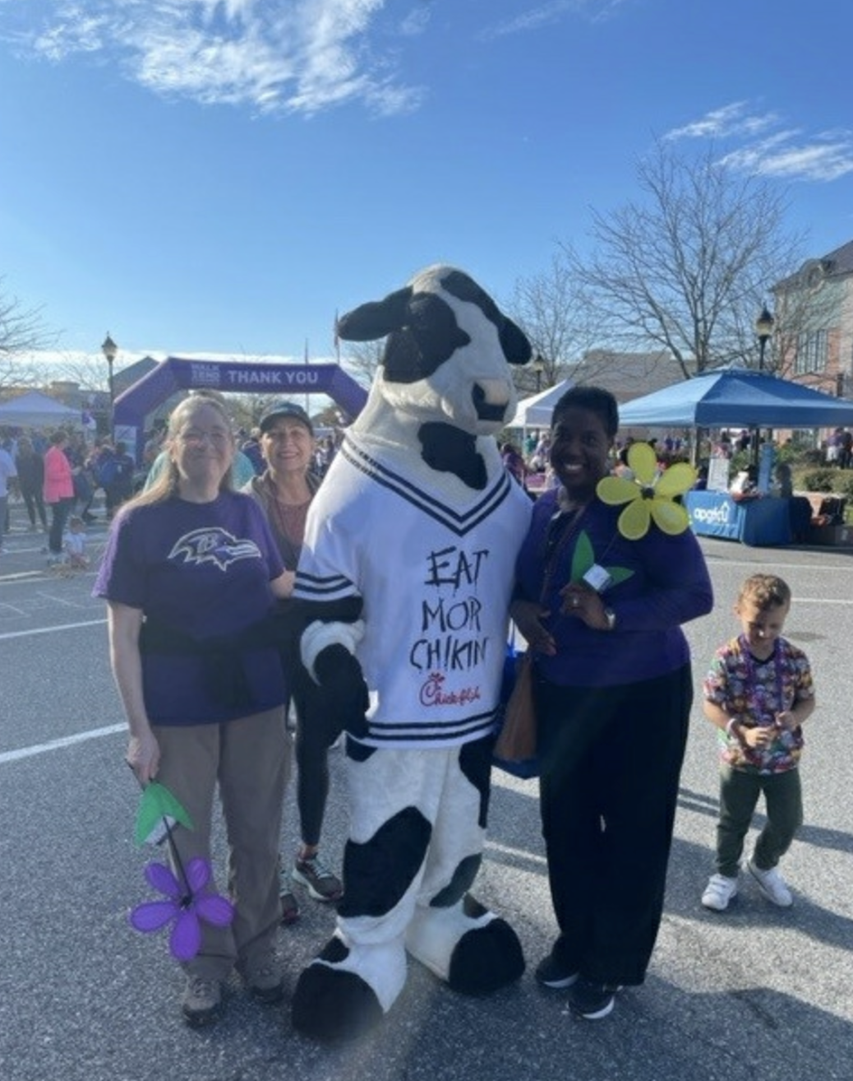
The Johns Hopkins
Aging & Alzheimer’s Centers
2023 #Walk2ENDAlz Team
The 2023 Johns Hopkins Aging & Alzheimer’s Centers Walk Team included 13 people: Karen Bandeen-Roche; Mindy Dmuchkowski; Ryan Dougherty; Cassie Gipson; Tracy Harvey; Emerald Jenkins; Jamal Jenkins; Corinne Pettigrew; Monique Lee; Jennifer Schrack; Ashley Scott; Anthony Teano; Veronica Washington.
Pictured: Karen Bandeen-Roche; Marcela Blinka; Chickfil-A mascot; and Monique Lee.

Slide 3
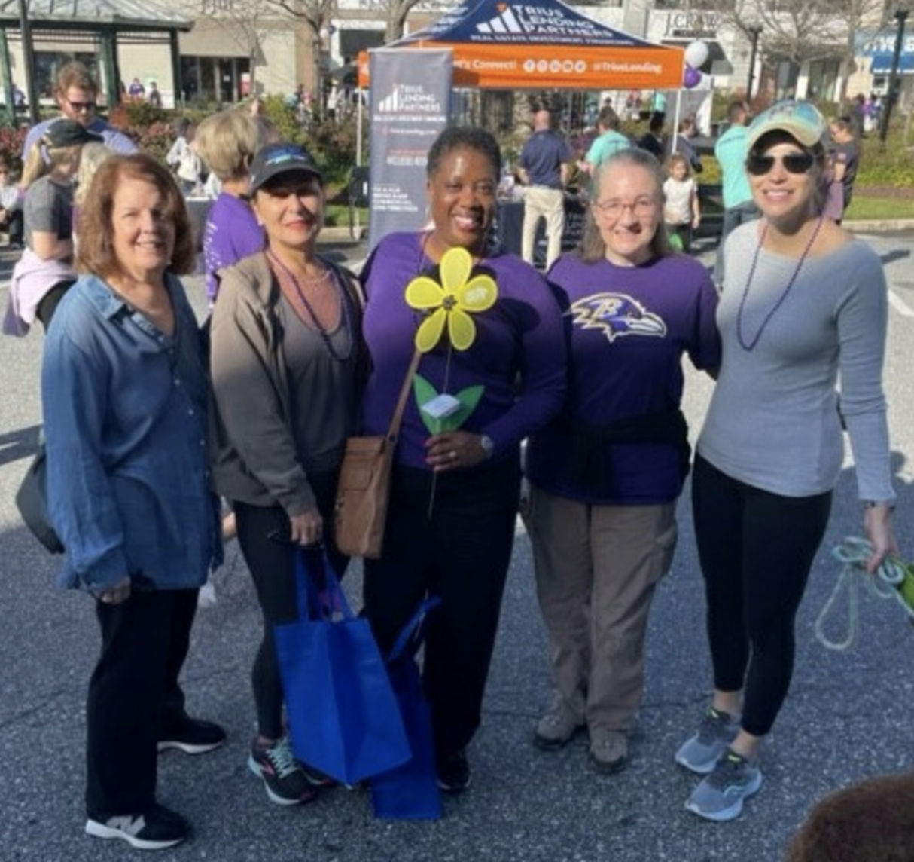
The Johns Hopkins
Aging & Alzheimer’s Centers
2023 #Walk2ENDAlz Team
The Baltimore Walk to End Alzheimer’s was held on October 28, 2023, by which time the team’s generous supporters donated $3,850!
We are very grateful to our supporters!
Pictured: Marilyn Albert; Marcela Blinka; Monique Lee; Karen Bandeen-Roche; and Jennifer Schrack.

